Slide 1
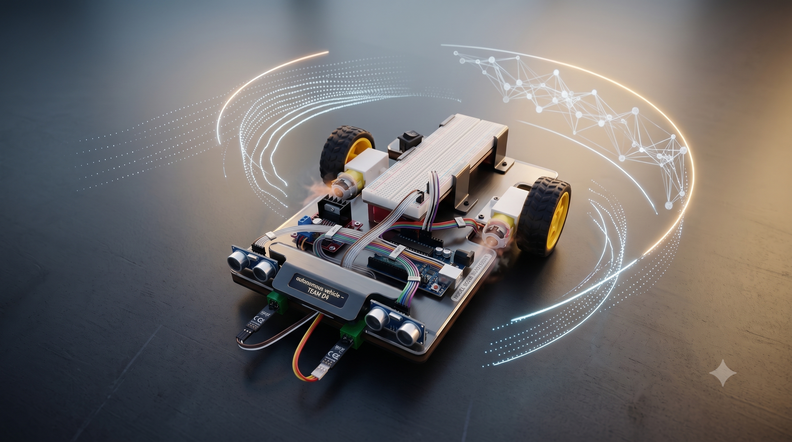



Slide 2





ELECTRICAL ENGINEERING | ELE
DESIGN AND IMPLEMENTATION OF AN AUTONOMOUS LINE-FOLLOWING AND OBSTACLE-AVOIDING ROBOT
Presented by ;
Dodly Forbi
Ye-Htet_Kyaw
Gabriel Tchakunte
Abdelmalek Abraham
ELE Systems Engineering SS2026

Slide 3
Slide 1
PRESENTATION OUTLINE
Project objectives & Requirements
System Engineering View
Hardware and Mechanical Design
Software and Control Logic
UML Diagrams
Testing and Results
Conclusion
Future Work

Slide 4

Slide 2
PROJECT OBJECTIVES & REQUIREMENTS
OBJECTIVES
CONSTRAINTS
Line Following
Arduino Uno only
Follow straight and curved tracks
Kit Components only including ;
Obstacle Detection and varied behaviour ;
A pair of Ultrasonic & IR sensors, L298N motor driver , 2 motors, breadboard , screws, wires and a custom chassis
Perform alternating responses such as obstacle dodging and 180° turn
Custom track
Environment

Slide 5
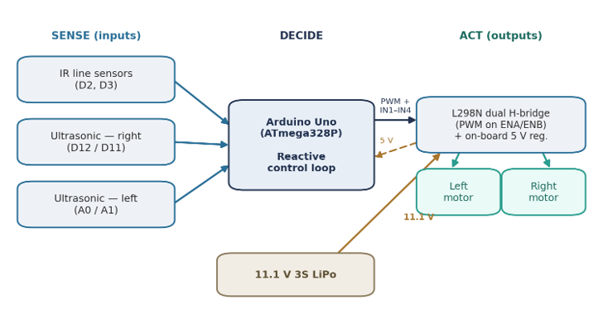
Slide 3
SYSTEM ENGINEERING VIEW
Inputs
2× IR sensors
2× HC-SR04 sensors
Controller
Arduino Uno
Outputs
L298N motor driver
Differential drive motors
Power
11.1V LiPo

Slide 6
ELECTRICAL ENGINEERING | ELE
Slide 4
HARDWARE AND MECHANICAL DESIGN
Presented by ;
Dodly Forbi
Ye-Htet_Kyaw
Gabriel Tchakunte
Abdelmalek Abraham
ELE Systems Engineering SS2026

Slide 7

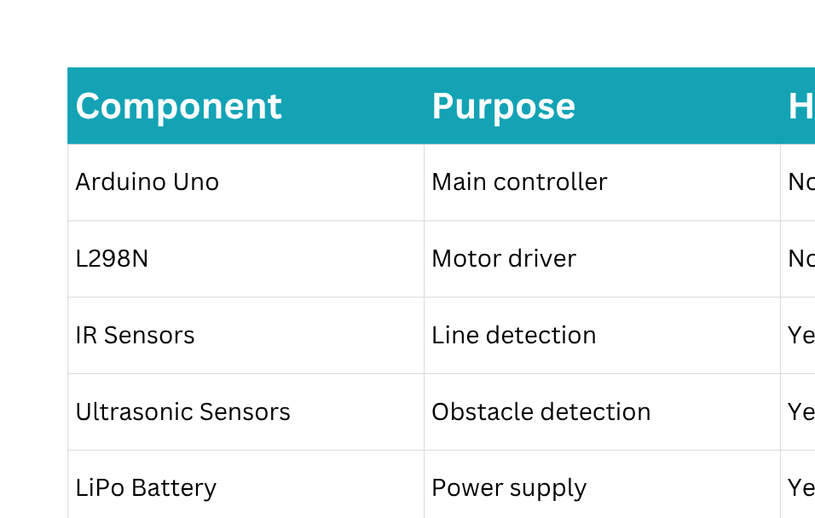



Slide 5
HARDWARE IMPLEMENTATION (1/5)
Mounts and Holders were designed on SolidWorks and then printed

Slide 8
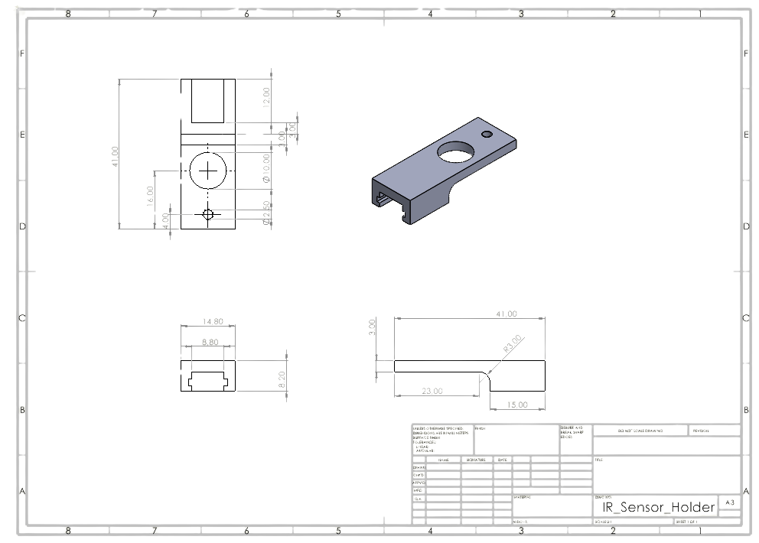
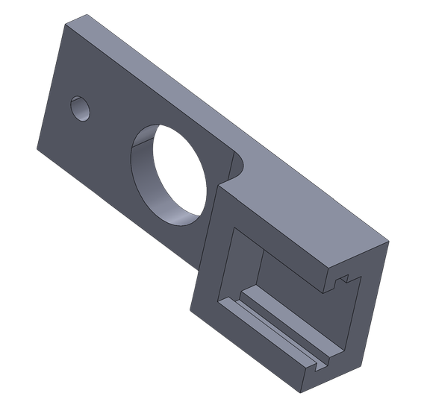
HARDWARE IMPLEMENTATION (2/5)
Slide 6
IR sensor Holder
Ye
Ye Htet Tchew

Slide 9
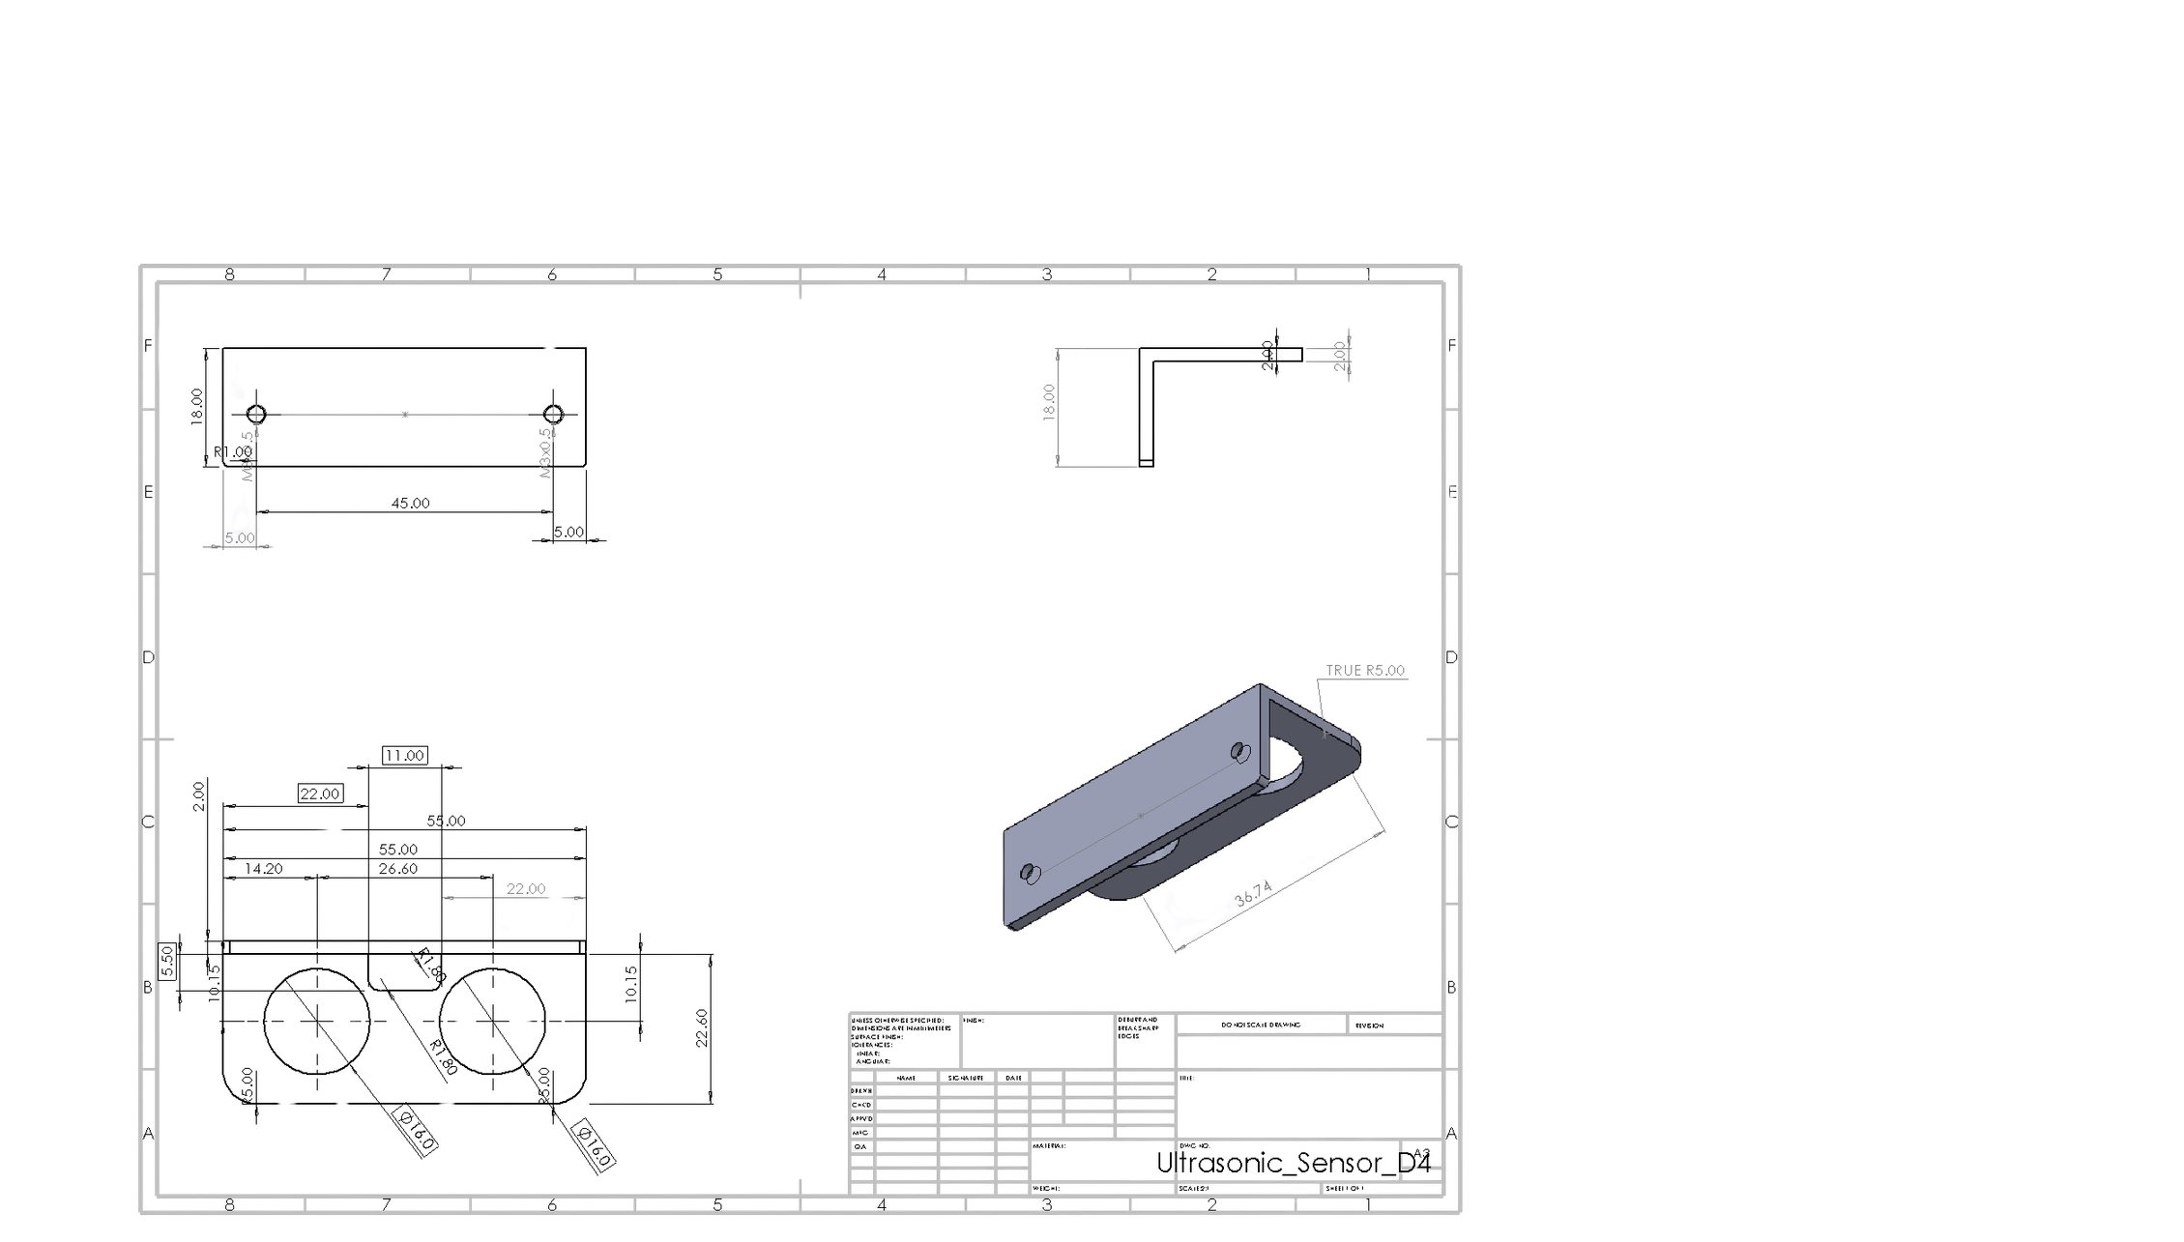
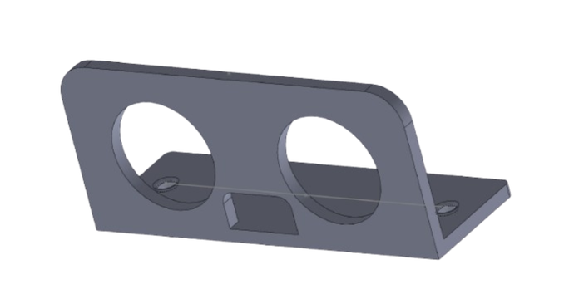
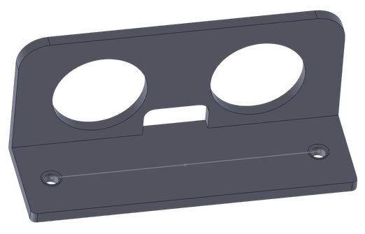
HARDWARE IMPLEMENTATION (3/5)
Slide 7
Ultrasonic Sensor Holder
Gabriel Tchakunte

Slide 10
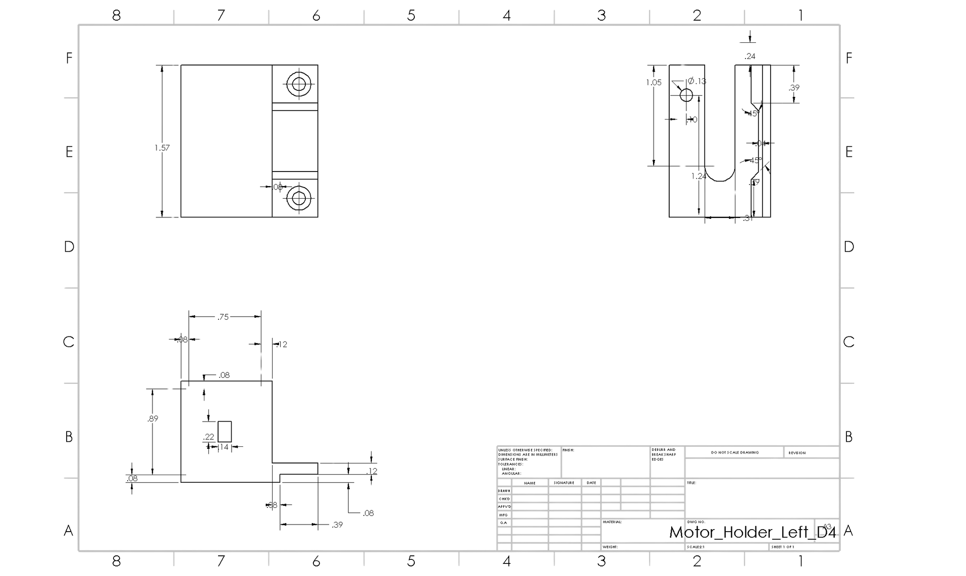
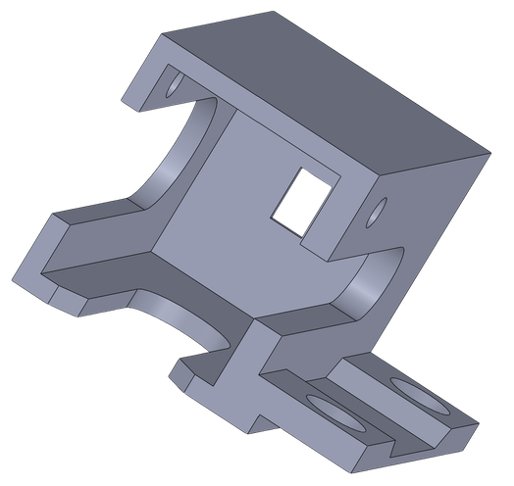
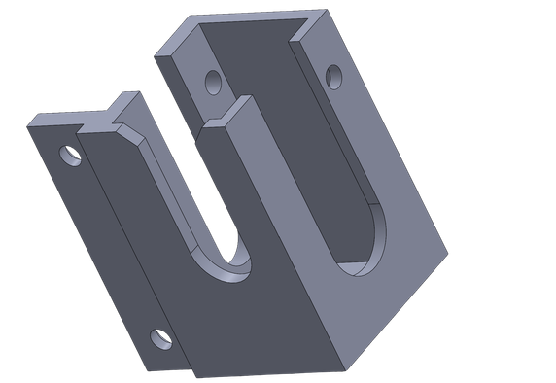
HARDWARE IMPLEMENTATION (4/5)
Slide 8
Ultrasonic Sensor
Abdelmalek Abraham

Slide 11
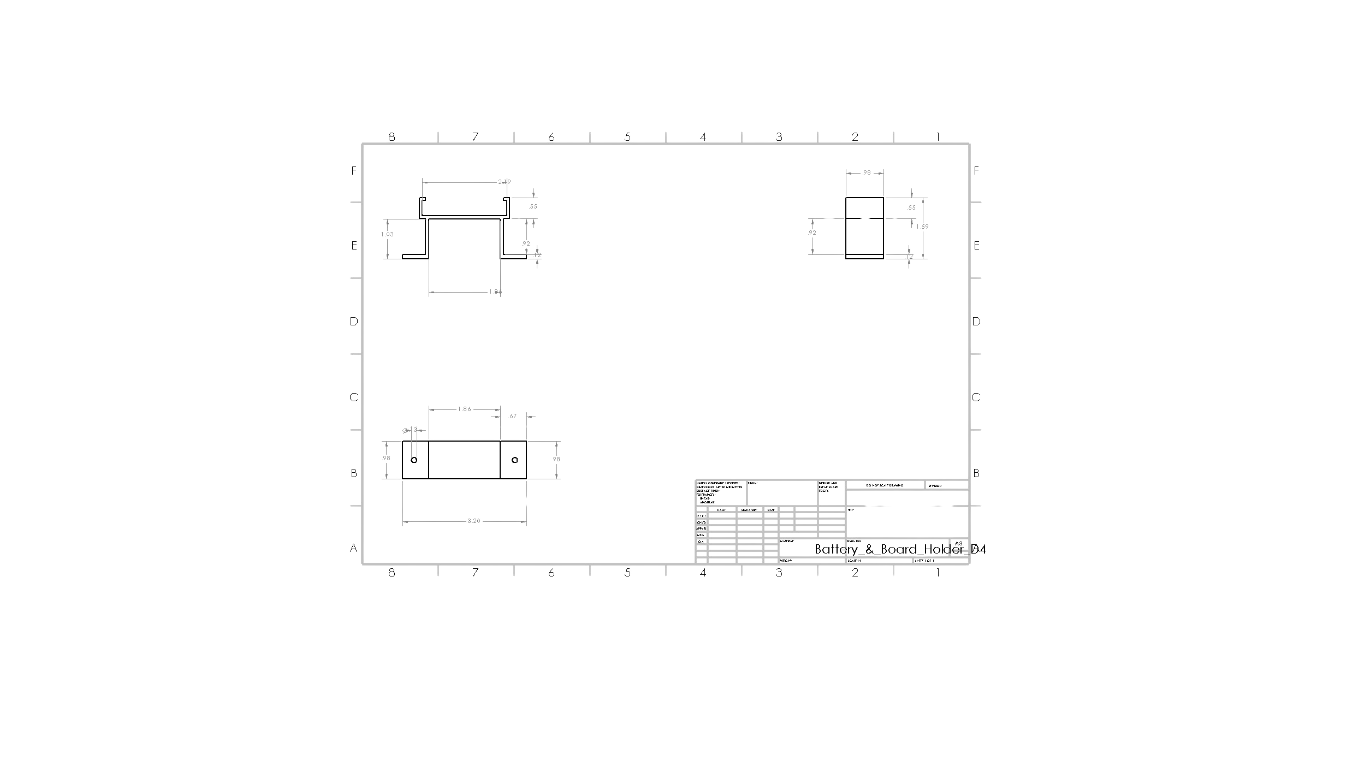

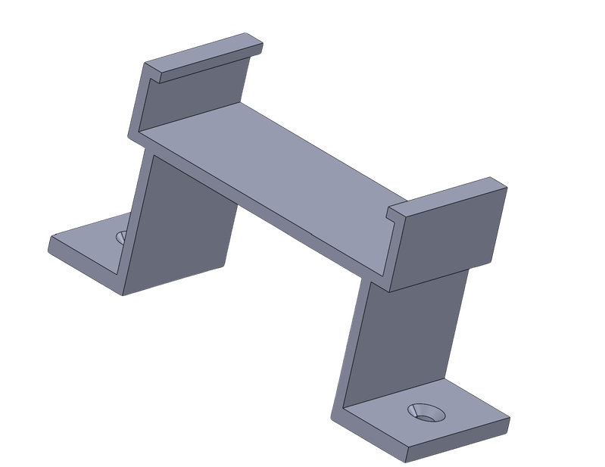
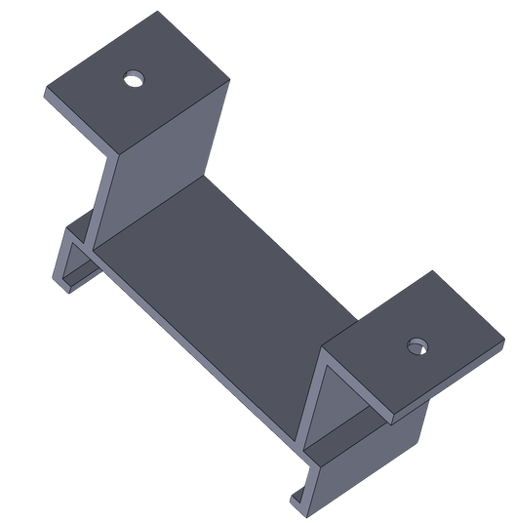
HARDWARE IMPLEMENTATION (5/5)
Slide 9
Battery/Breadboard Holder
Dodly Forbi

Slide 12
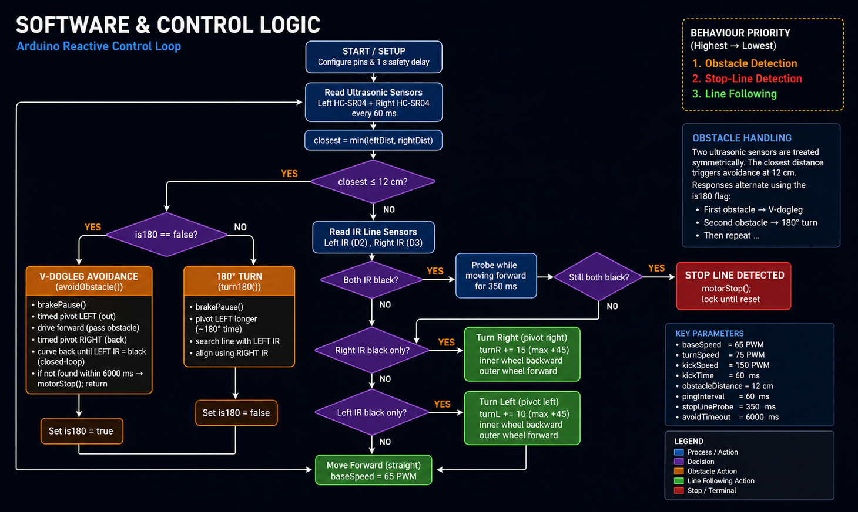
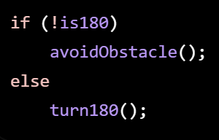
Slide 10
SOFTWARE & CONTROL LOGIC (1/3)
Two ultrasonic sensors checked every 60 ms
Closest distance triggers obstacle response at 12 cm
is180 alternates V-dogleg and 180° turn

Slide 13
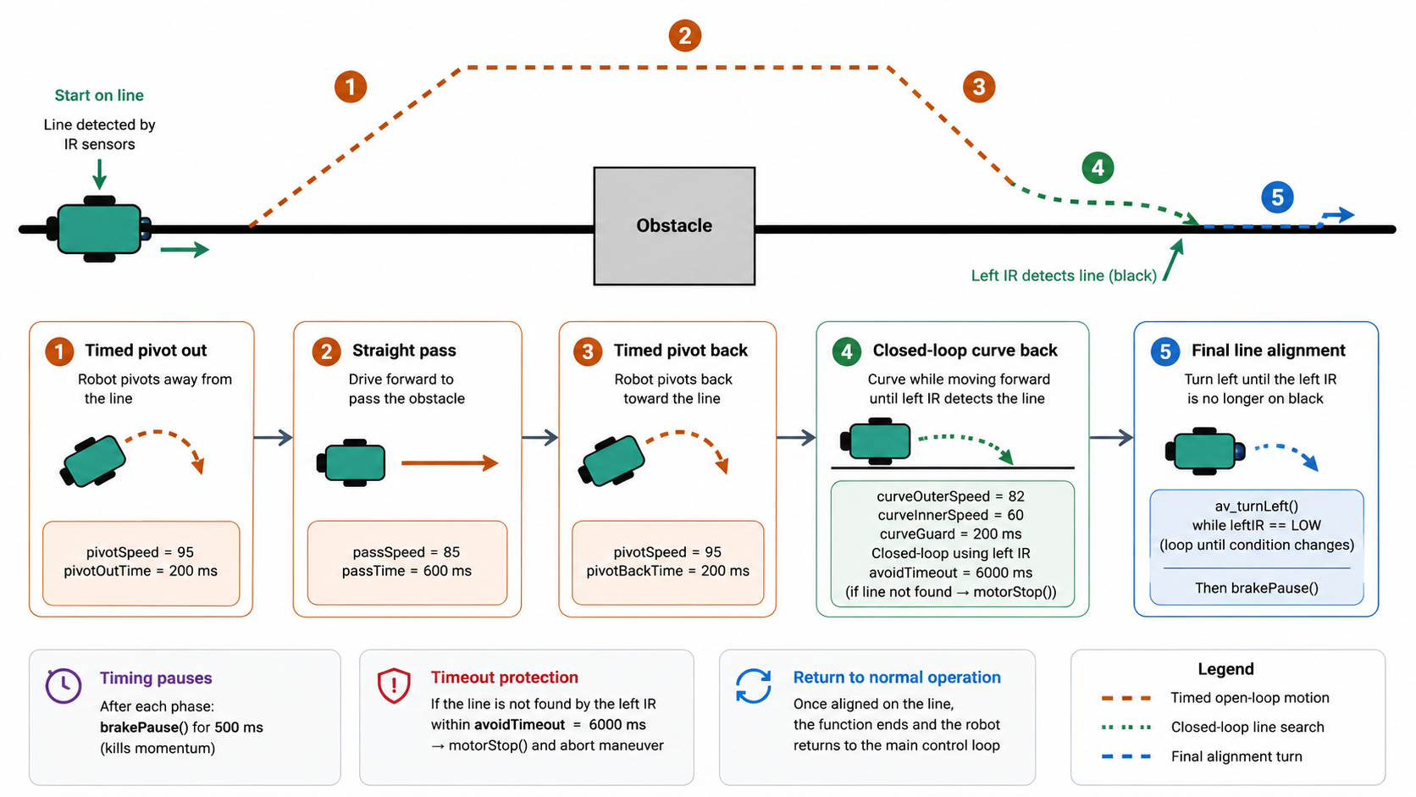
Slide 11
SOFTWARE & CONTROL LOGIC (2/3)
V dogleg dodge

Slide 14
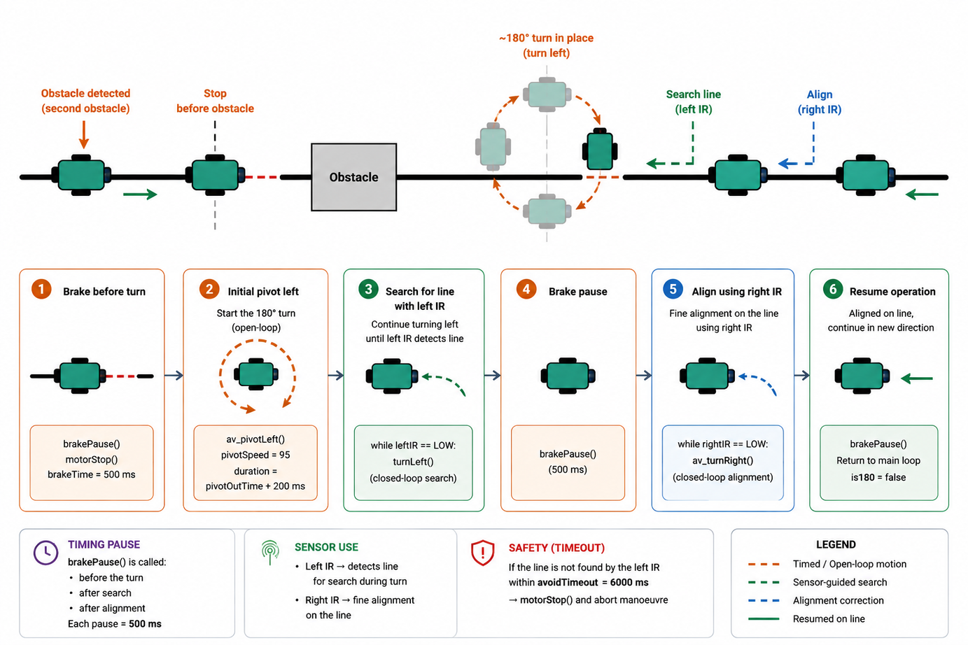
Slide 12
SOFTWARE & CONTROL LOGIC (3/3)
180° turn

Slide 15
ELECTRICAL ENGINEERING | ELE
Slide 13
UML DIAGRAMS
Presented by ;
Dodly Forbi
Ye-Htet_Kyaw
Gabriel Tchakunte
Abdelmalek Abraham
ELE Systems Engineering SS2026

Slide 16
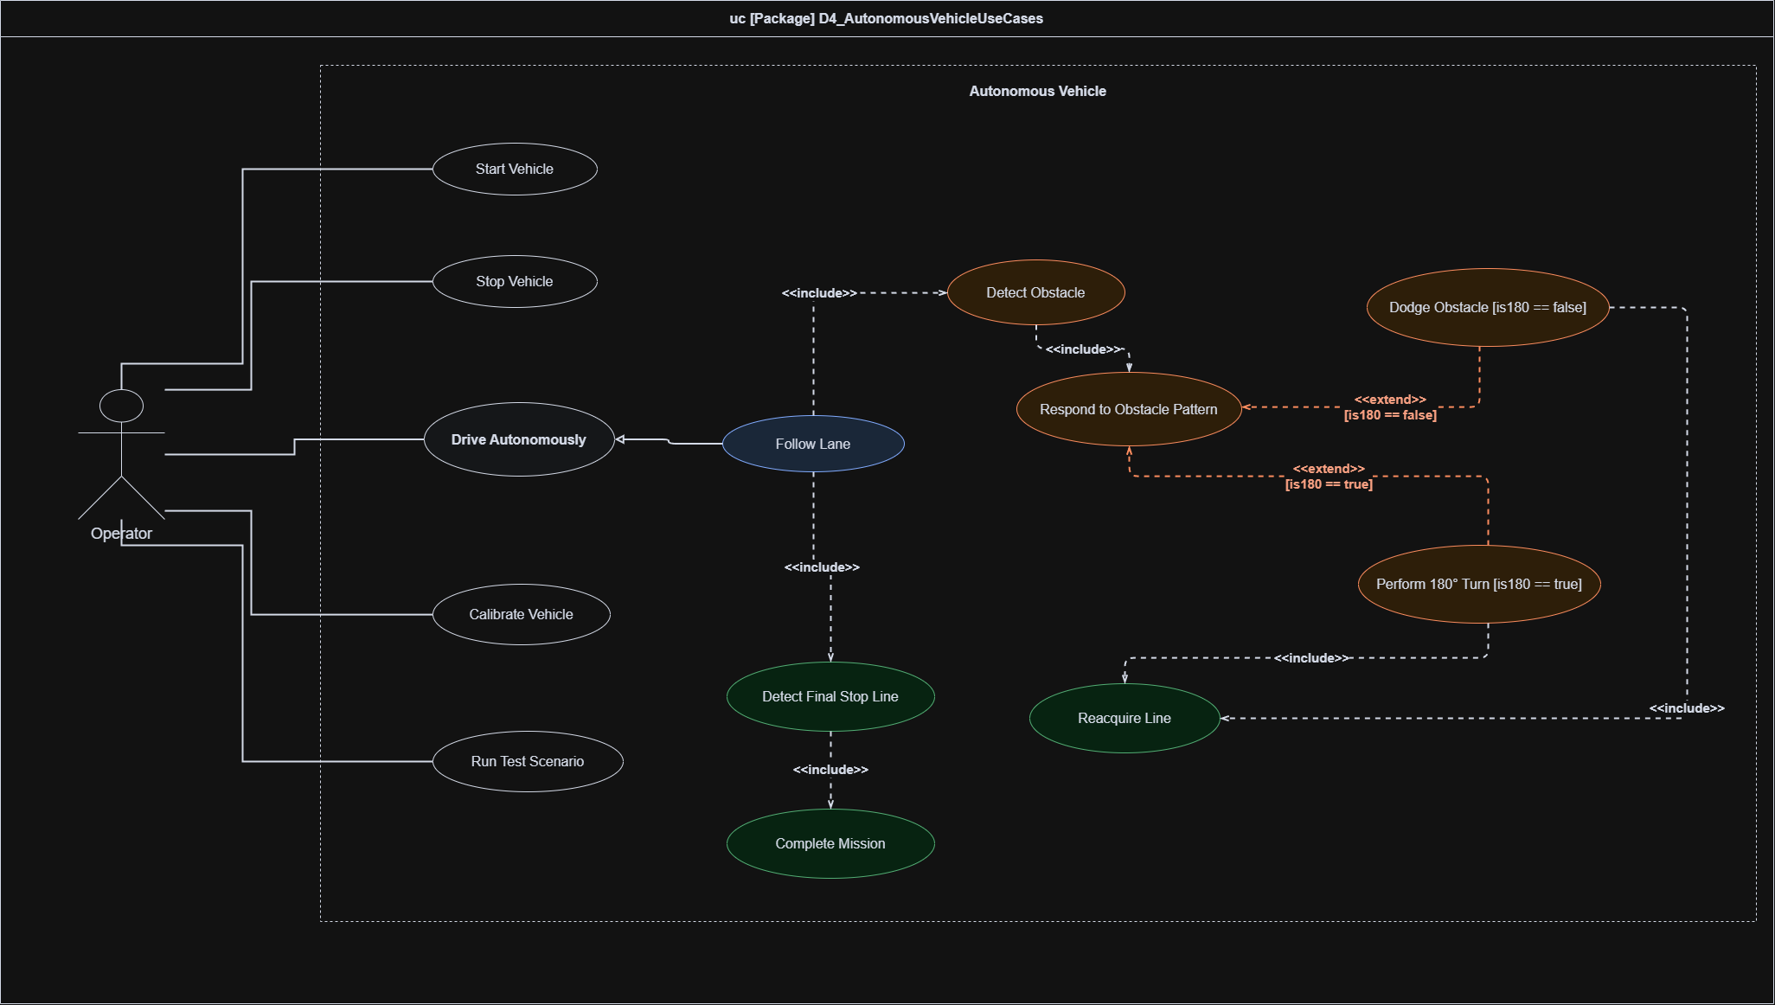


USE CASE DIAGRAM
Slide 14

Slide 17

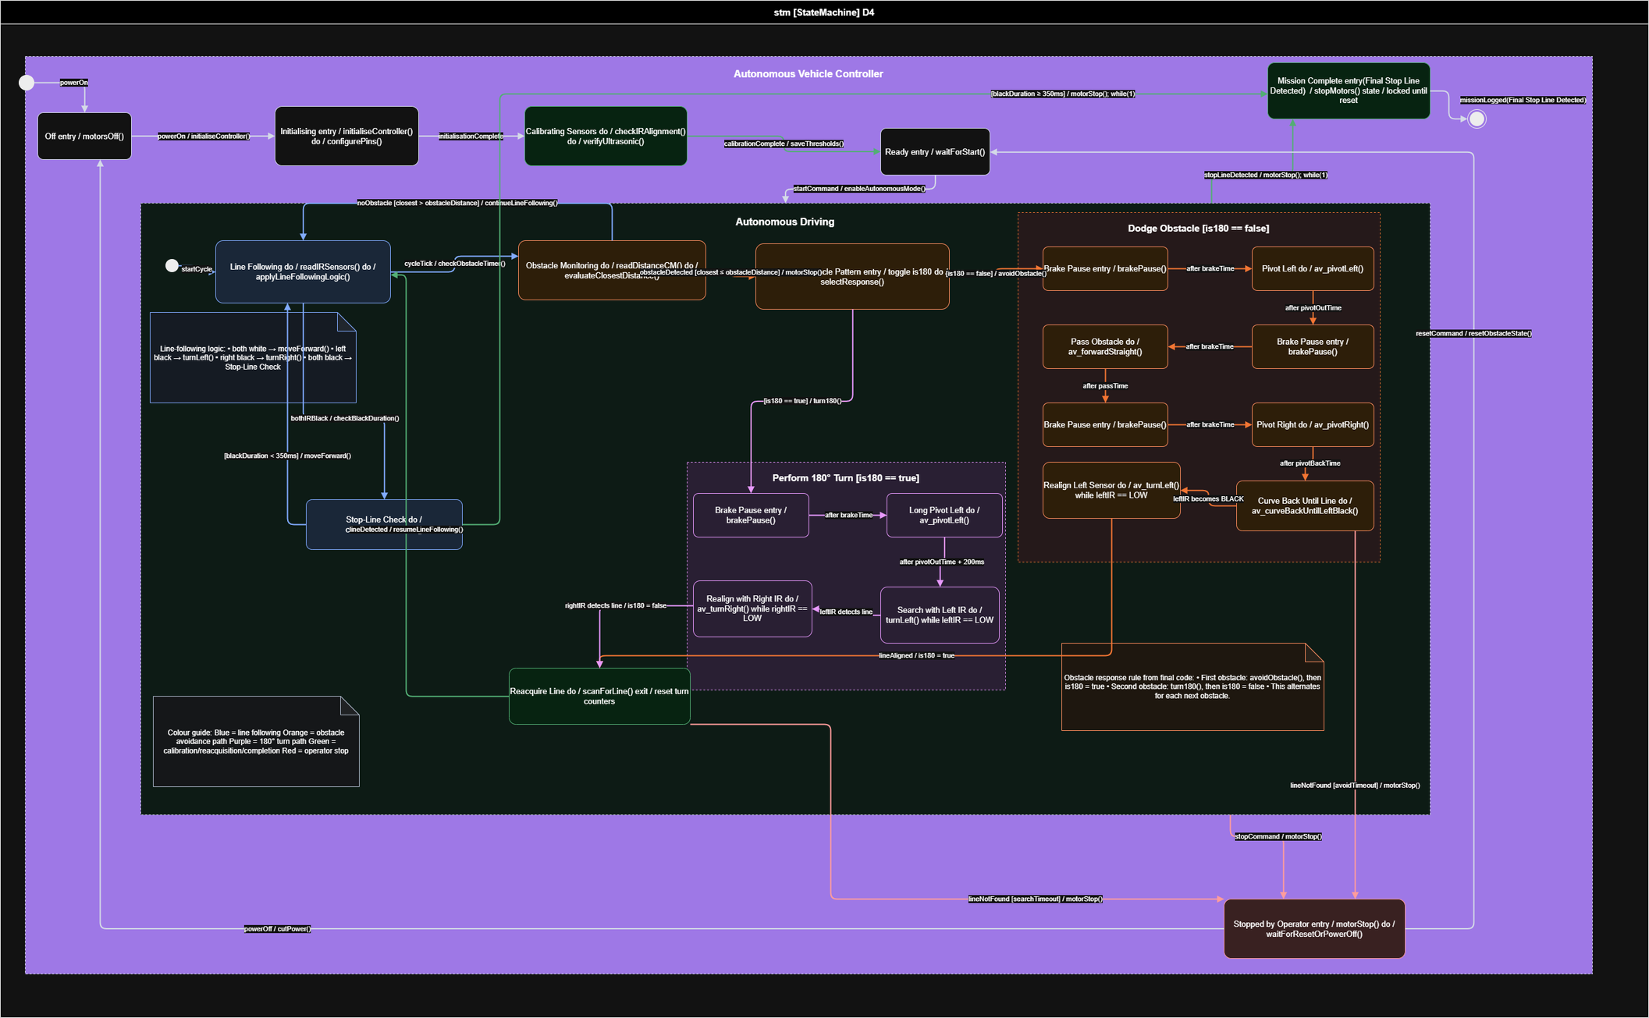
STATE MACHINE
DIAGRAM
Slide 15

Slide 18
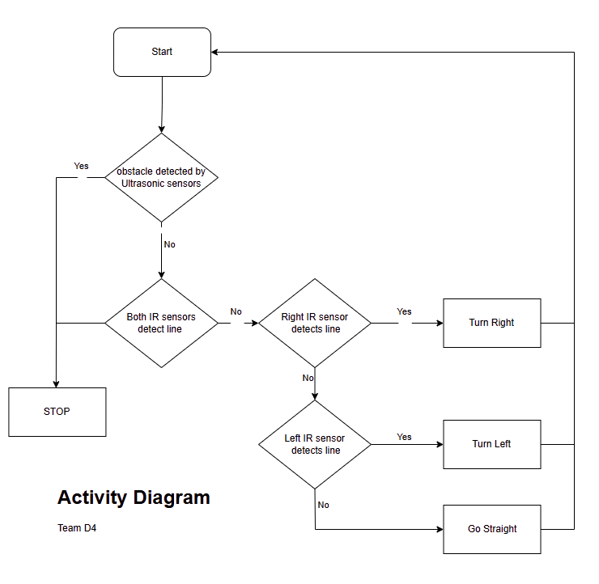
ACTIVITY DIAGRAM
Slide 16

Slide 19
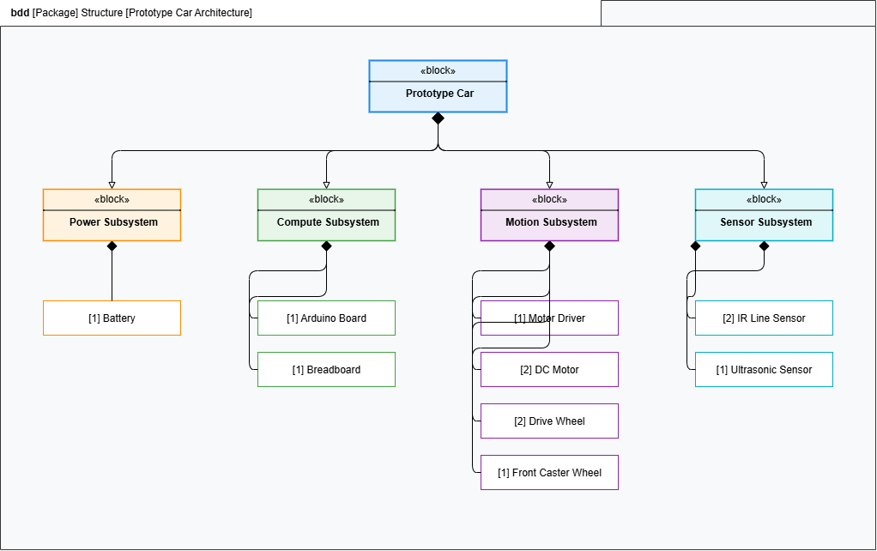
Slide 17
PACKAGE DIAGRAM

Slide 20
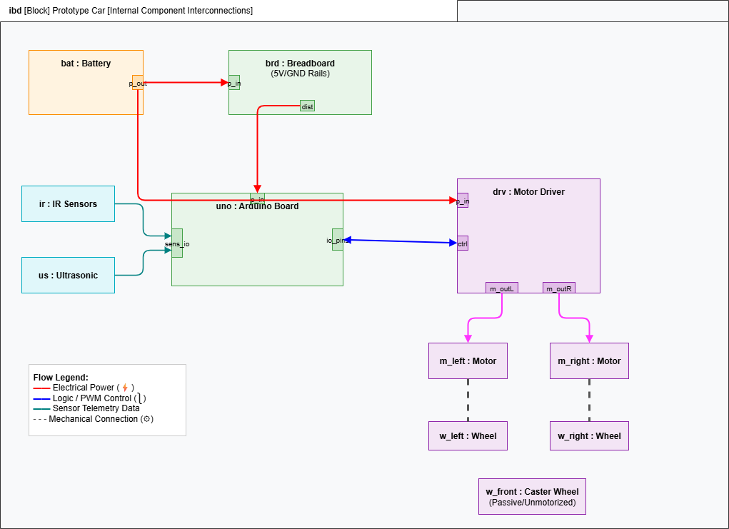
Slide 18
BLOCK COMPONENT DIAGRAM

Slide 21
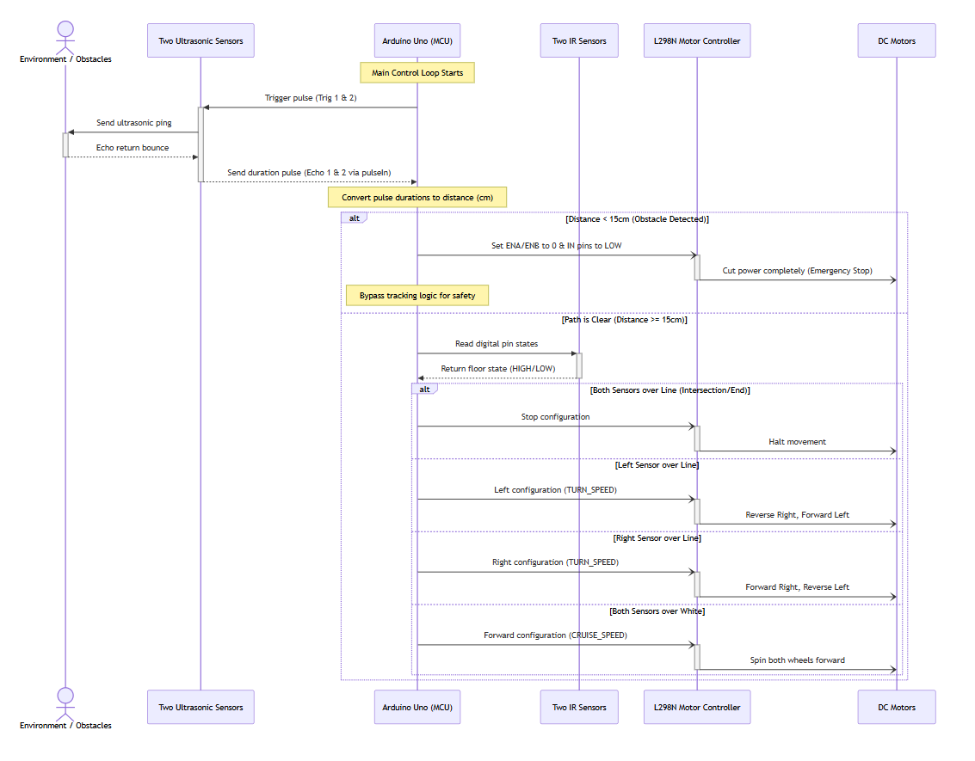
SEQUENCE DIAGRAM
Slide 19

Slide 22
Slide 20
TESTING & RESULTS
Test Photo #1
Test Photo #2
Test Photo #3

Slide 23
Slide 21
TESTING & RESULTS (2/2)
RESULTS
Motor completed track in 48secs without obstacle manoeuvring
Static friction required kick-start PWM.
Physical testing outperformed simulation.
Sensor placement mattered more than expected.
Mechanical robustness required multiple redesigns.

Slide 24
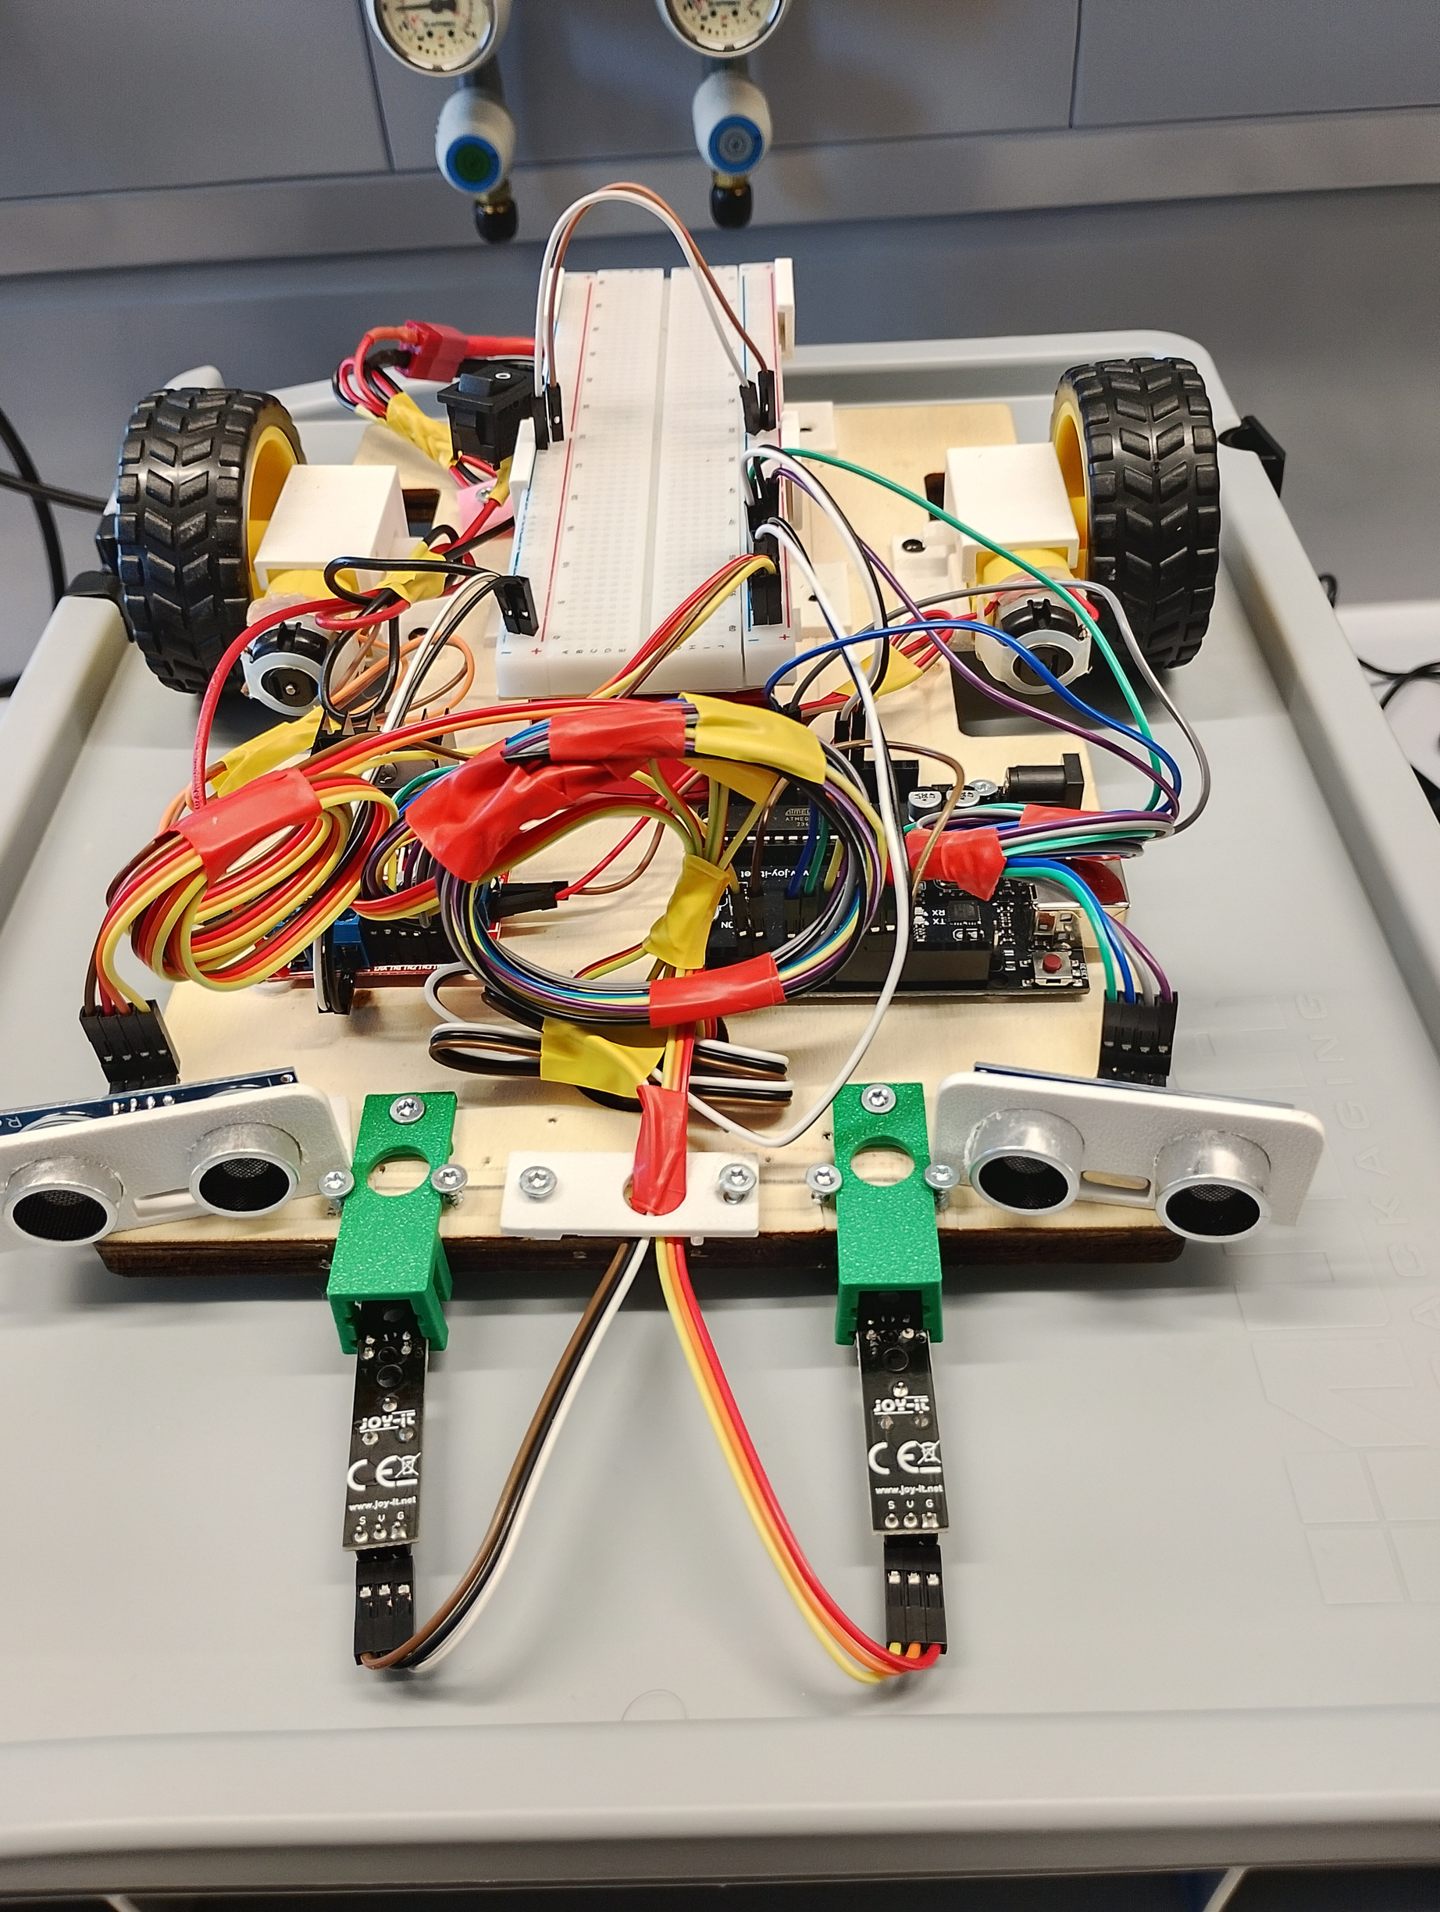
Slide 22
CONCLUSIONS
ACHIEVEMENTS
✅Met all objectives
✅ Used only project-kit hardware
✅ Reliable autonomous behaviour
✅ Complete documentation
✅ Team Collaboration on Github

Slide 25

Slide 23
FUTURE WORK
PID line following
Wheel encoders
Adaptive IR calibration
Vision-based navigation

Slide 26

Thank
You
for your keen attention.
Questions , comments ?

